Slide 1
Lecture 04: 80X86 Microprocessor

Slide 2
Key Content
Internal organization of 8086
Registers, pipelining
Chip interface of 8086
Memory management in 8086
Addressing mode in 8086

Slide 3
Key Content
Internal organization of 8086
Registers, pipelining
Chip interface of 8086
Memory management in 8086
Addressing mode in 8086

Slide 4
The 80x86 IBM PC and Compatible Computers
Chapter 1
80X86 Microprocessor
Chapter 9.1
8088 Microprocessor

Slide 5
Evolution of 80X86 Family
8086, born in 1978
First 16-bit microprocessor
20-bit address data bus, i.e. 2²⁰ = 1MB memroy
First pipelined microprocessor
8088
Data bus: 16-bit internal, 8-bit external
Fit in the 8-bit world, e.g., motherboard, peripherals
Adopted in the IBM PC + MS-DOS open system
80286, 80386, 80486
Real/protected modes
Virtual memory

Slide 6
Internal Structure of 8086
Two sections
Bus interface unit (BIU): accesses memory and peripherals
Execution unit (EU): executes instructions previously fetched
Work simultaneously

Slide 7
Internal Structure of 8086

Slide 8
Bus Interface Unit
Take in charge of data transfer between CPU and memory and I/O devices as well
Instruction fetch, instruction queuing, operand fetch and storage, address relocation and Bus control
Consists of :
four 16-bit segment registers: CS, DS, ES, SS
One 16-bit instruction pointer: IP
One 20-bit address adder: e.g., CS left-shifted by 4 bits + IP (CS*16+IP)
A 6-byte instruction queue
While the EU is executing an instruction, the BIU will fetch the next one or several instructions from the memory and put in the queue

Slide 9
Execution Unit
Take in charge of instruction execution
Consists of:
Four 16-bit general registers: Accumulator (AX), Base (BX), Count (CX) and Data (DX)
Two 16-bit pointer registers: Stack Pointer (SP), Base Pointer (BP)
Two 16-bit index registers: Source Index (SI) and Destination Index (DI)
One 16-bit flag register: 9 of the 16 bits are used
ALU

Slide 10
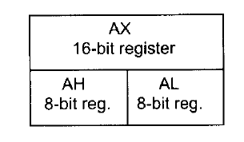

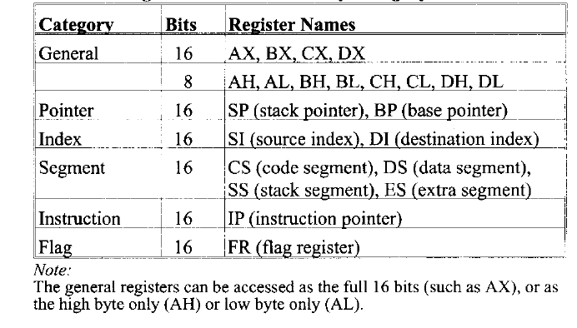
Registers
On-chip storage: super fast & expensive
Store information temporarily
Six groups

Slide 11

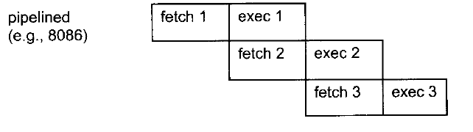
Pipelining in 8086
BIU fetches and stores instructions once the queue has more than 2 empty bytes
EU consumes instructions pre-fetched and stored in the queue at the same time
Increases the efficiency of CPU
When it works?
Sequential instruction execution
Branch penalty: when jump instruction executed, all pre-fetched instructions are discarded

Slide 12
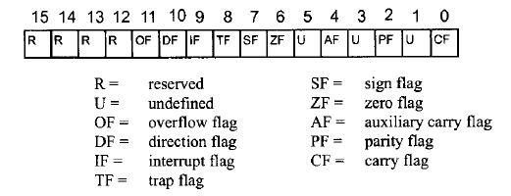
Flag Register
16-bit, status register, processor status word (PSW)
6 conditional flags
CF, PF, AF, ZF, SF, and OF
3 control flags
DF, IF, TF

Slide 13
Conditional Flags
CF (Carry Flag): set whenever there is a carry out, from d7 after a 8-bit op, from d15 after a 16-bit op
PF (Parity Flag): the parity of the op result’s low-order byte, set when the byte has an even number of 1s
AF (Auxiliary Carry Flag): set if there is a carry from d3 to d4, used by BCD-related arithmetic
ZF (Zero Flag): set when the result is zero
SF (Sign Flag): copied from the sign bit (the most significant bit) after op
OF (Overflow Flag): set when the result of a signed number operation is too large, causing the sign bit error

Slide 14
Signed Number
Original value 原码
Can’t be added directly
Two zeros (+0/-0)
One’s complement 反码
Can be added directly
Two zeros (+0/-0)
Two’s complement 补码
Can be added directly
Only one zero
Value | Original value | One’s complement | Two’s complement
+0 | 0000 0000 | 0000 0000 | 0000 0000
-0 | 1000 0000 | 1111 1111 | 0000 0000
+1 | 0000 0001 | 0000 0001 | 0000 0001
-1 | 1000 0001 | 1111 1110 | 1111 1111

Slide 15

More about Signed Number, CF&OF
The most significant bit (MSB) as sign bit, the rest of bits as magnitude
For negative numbers, D7 is 1, but the magnitude is represented in 2’s complement
CF is used to detect errors in unsigned arithmetic operations
OF is used to detect errors in signed arithmetic operations
Two ways to understand the OF
1. OF = 1, when two values are positive, but the result is negative; when two values are negative, but the result is positive
2. E.g., for 8-bit ops, OF is set to 1 when there is a carry from d6 to d7 and no carry from d7;or when there is a carry from d7 and no carry from d6 to d7

Slide 16


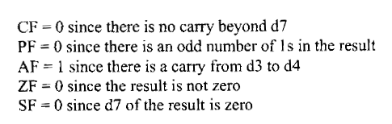



Examples of Conditional Flags
How can CPU know whether an operation is unsigned or signed?
OF = 0 since there is no carry from d6 to d7 and no carry beyond d7
Notes:
In CPU, we have an adder circuitry but no subtractor circuitry so when doing subtraction x-y, we add x to the 2’s complement of y.
What’s 2’s complement of a binary number? Invert all bits and then add 1 to the result.

Slide 17
Control Flags
IF (Interrupt Flag): set or cleared to enable or disable only the external maskable interrupt requests
After reset, all flags are cleared which means you (as a programmer) have to set IF in your program if allow INTR.
DF (Direction Flag): indicates the direction of string operations
TF (Trap Flag): when set it allows the program to single-step, meaning to execute one instruction at a time for debugging purposes

Slide 18
Key Content
Internal organization of 8086
Registers, pipelining
Chip interface of 8086
Memory management in 8086
Addressing mode in 8086

Slide 19
8086/8088 Pins (Compare them and tell the difference)

Slide 20
Minimum Mode Configuration
8086/88’s two work modes:
Minimum mode： =1
Single CPU;
Control signals from the CPU
Maximum mode： =0
Multiple CPUs(8086+8087)
8288 control chip supports

Slide 21
Control Signals
MN/~MX: Minimum mode (high level), Maximum mode (low level)
~RD: output, CPU is reading from memory or IO
~WR: output, CPU is writing to memory or IO
M/~IO: output, CPU is accessing memory (high level) or IO (low level)
READY: input, memory/IO is ready for data transfer
~DEN: output, used to enable the data transceivers
DT/~R: output, used to inform the data transceivers the direction of data transfer, i.e., sending data (high level) or receiving data (low level)
~BHE: output, ~BHE=0, AD8-AD15 are used, ~BHE=1, AD8-AD15 are not in use
ALE: output, used as the latch enable signal of the address latch

Slide 22
Control Signals
HOLD: input signal, hold the bus request
HLDA: output signal, hold request ack
INTR: input, interrupt request from 8259 interrupt controller, maskable by clearing the IF in the flag register
INTA: output, interrupt ack
NMI: input, non-maskable interrupt, CPU is interrupted after finishing the current instruction; cannot be masked by software
RESET: input signal, reset the CPU
IP, DS, SS, ES and the instruction queue are cleared
CS = FFFFH
What is the address of the first instruction that the CPU will execute after reset?
Notes:
H represents hexadecimal numbers

Slide 23
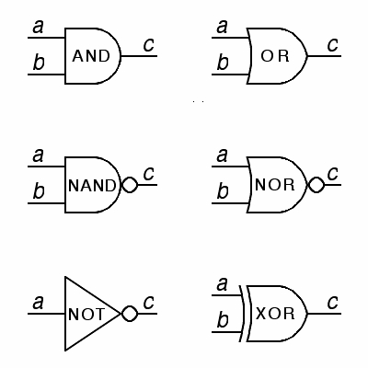
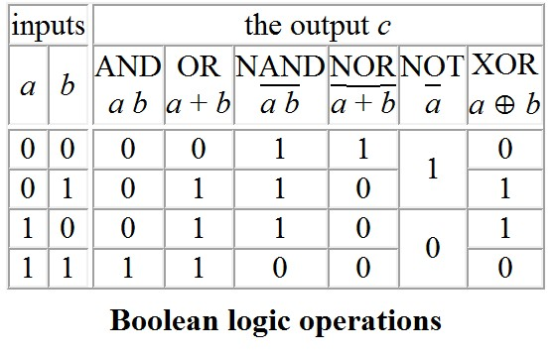
Remember CMOS Gates?
These following gates are called combinational logic (组合逻辑电路)
The output is only determined by the input (输出仅仅由输入决定）

Slide 24
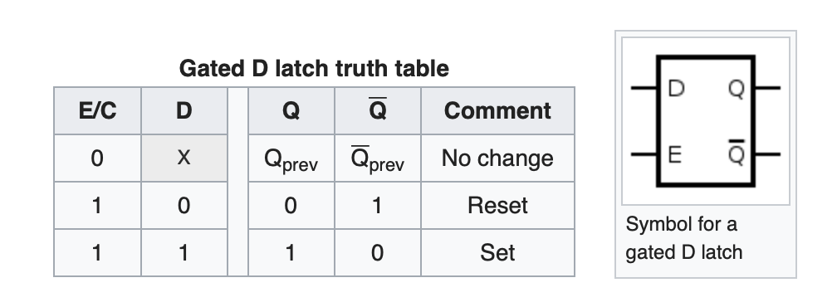
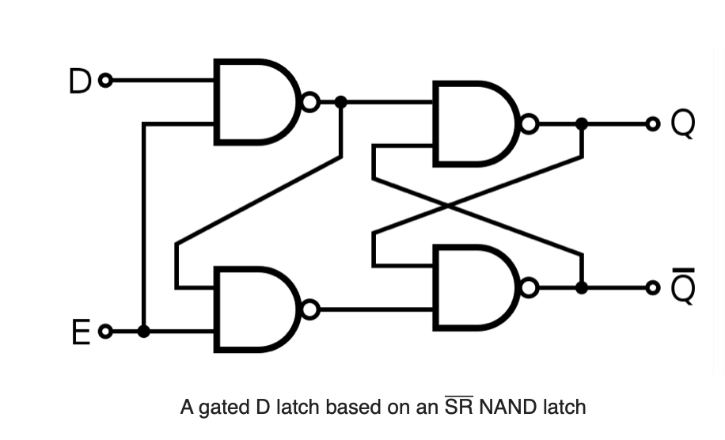
Sequential Logic 时序逻辑电路
D Latch: D锁存器
Logically, D-latch is the same as a SRAM cell

Slide 25
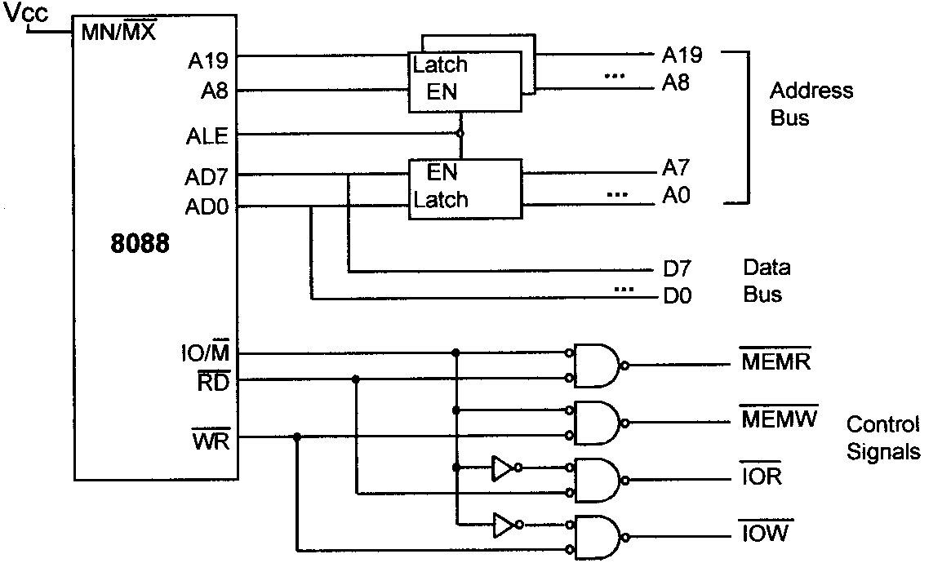
Memory/IO Control Signals

Slide 26
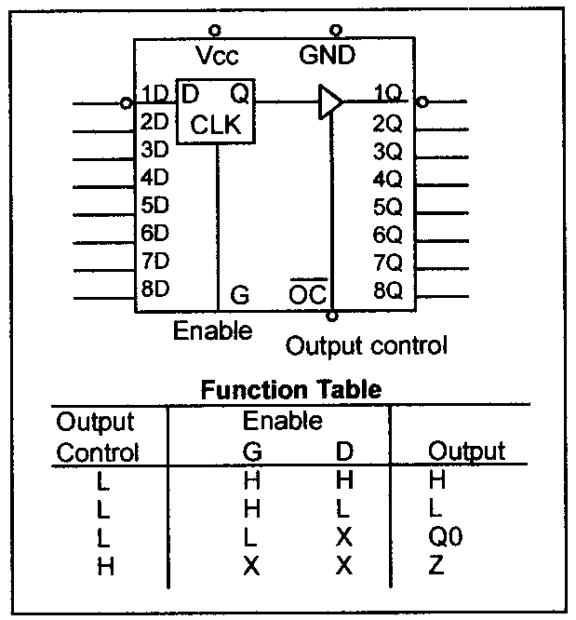

Address/Data Demultiplexing & Address latching
Notes:
Z represent the high-impedance state

Slide 27
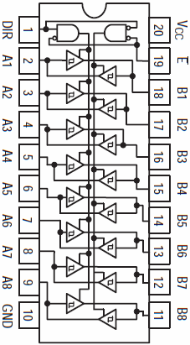
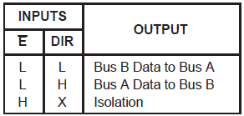
Data Bus Transceiver

Slide 28
8086/88 Bus Cycle (for data transfers)
At least 4 clock cycles
Notes:
8086读周期时序:
在8086读周期内,有关总线信号的变化如下:
M/IO在整个读周期保持有效,当进行存储器读操作时,M/IO为高电平;当进行I/O端口读操作时,M/IO为低电平.
A19/S6～A16/S3是在T1期间,输出CPU要读取的存储单元的地址高4位.T2～T4期间输出状态信息S6～S3.
BHE/S7在T1期间输出BHE有效信号(BHE为低电平),表示高8位数据总线上的信息可以使用,BHE信号通常作为奇地址存储体的选择信号(偶地址存储体的选择信号是最低地址位A0).T2～T4期间输出高电平.
ADl5～AD0在T1期间输出CPU要读取的存储单元或I/O端口的地址A15～A0.T2期间为高阻态,T3～T4期间,存储单元或I/O端口将数据送上数据总线.CPU从ADl5～AD0上接收数据.
ALE:在T1期间地址锁存有效信号,为一正脉冲,系统中的地址锁存器正是利用该脉冲的下降沿来锁存A19/S6～A16/S3,ADl5～AD0中的20位地址信息以及BHE.
RD在T2期间输出低电平,送到被选中的存储器或I/O接口.要注意的是,只有被地址信号选中的存储单元或I/O端口,才会被RD信号从中读出数据(数据送上数据总线ADl5～AD0).
DT/R在整个总线周期内保持低电平,表示本总线周期为读周期.在接有数据总线收发器的系统中,用来控制数据传输的方向.
DEN在T2～T3期间输出有效低电平,表示数据有效.在接有数据总线收发器的系统中,用来实现数据的选通.
8086写周期时序总线写操作的时序与读操作时序相似,其不同处在于:
ADl5～AD0在T2～T4期间送上欲输出的数据,而无高阻态.
WR在T2～T4期间输出有效低电平,该信号送到所有的存储器和I/O接口.要注意的是,只有被地址信号选中的存储单元或I/O端口才会被WR信号写入数据.
DT/R在整个总线周期内保持高电平,表示本总线周期为写周期.在接有数据总线收发器的系统中,用来控制数据传输方向.

Slide 29
Key Content
Internal organization of 8086
Registers, pipelining
Chip interface of 8086
Memory management in 8086
Addressing mode in 8086

Slide 30
8086 Programming
A typical program on 8086 consists of at least three segments
code segment: contains instructions that accomplish certain tasks
data segment: stores information to be processed
stack segment: store information temporarily
What is a segment?
A memory block includes up to 64KB. Why?
Begins on an address evenly divisible by 16, i.e., an address looks like in XXXX0H. Why?

Slide 31
Logical & Physical Address
Physical address
20-bit address that is actually put on the address bus
A range of 1MB from 00000H to FFFFFH
Actual physical location in memory
Logical address
Consists of a segment value (determines the beginning of a segment) and an offset address (a relative location within a 64KB segment)
E.g., an instruction in the code segment has a logical address in the form of CS (code segment register):IP (instruction pointer)

Slide 32

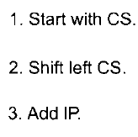
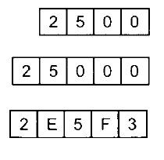
Logical & Physical Address
logical address -> physical address
Shift the segment value left one hex digit (or 4 bits)
Then adding the above value to the offset address
One logical -> only one physical
Segment range representation
Maximum 64KB
logical 2500:0000 – 2500:FFFF
Physical 25000H – 34FFFH (25000 + FFFF)

Slide 33
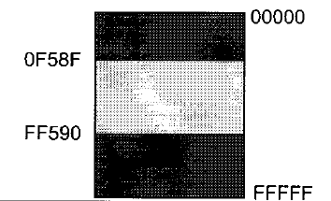
Physical Address Wrap-around
When adding the offset to the shifted segment value results in an address beyond the maximum value FFFFFH
E.g., what is the range of physical addresses if CS=FF59H?
Solution:
The low range is FF590H, and
the range goes to FFFFFH and
wraps around from 00000H to
0F58FH (FF590+FFFF).

Slide 34
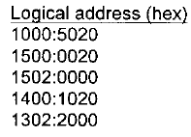
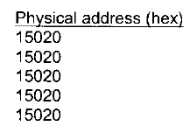
Logical & Physical Address
Physical address -> logical address ?
One physical address can be derived from different logical addresses
E.g.,

Slide 35
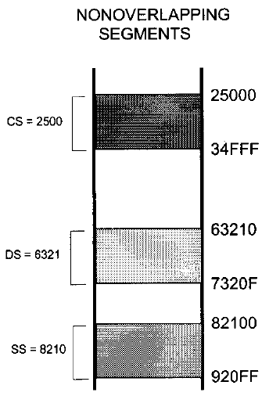
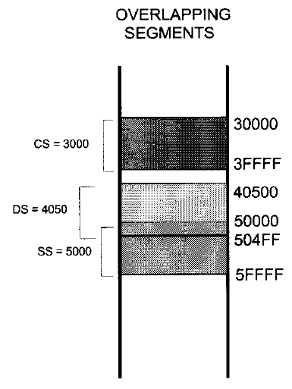
Segment Overlapping
Two segments can overlap
Dynamic behaviour of the segment and offset concept
May be desirable in some circumstances

Slide 36
Code Segment
8086 fetches instructions from the code segment
Logical address of an instruction: CS:IP
Physical address is generated to retrieve this instruction from memory
What if desired instructions are physically located beyond the current code segment?
Solution: Change the CS value so that those instructions can be located using new logical addresses

Slide 37
Data Segment
Information to be processed is stored in the data segment
Logical address of a piece of data: DS:offset
Offset value: e.g., 0000H, 23FFH
Offset registers for data segment: BX, SI and DI
Physical address is generated to retrieve data (8-bit or 16-bit) from memory
What if desired data are physically located beyond the current data segment?
Solution: Change the DS value so that those data can be located using new logical addresses

Slide 38
Data Representation in Memory
Memory can be logically imagine as a consecutive block of bytes
How to store data whose size is larger than a byte?
Little endian: the low byte of the data goes to the low memory location
Big endian: the high byte of the data goes to the low memory location
E.g., 2738H

Slide 39
Stack Segment
A section of RAM memory used by the CPU to store information temporarily
Logical address of a piece of data: SS:SP (special applications with BP)
Most registers (except segment registers and SP) inside the CPU can be stored in the stack and brought back into the CPU from the stack using push and pop, respectively
Grows downward from upper addresses to lower addresses in the memory allocated for a program
Why? To protect other programs from destruction
Note: Ensure that the code section and stack section would not write over each other

Slide 40
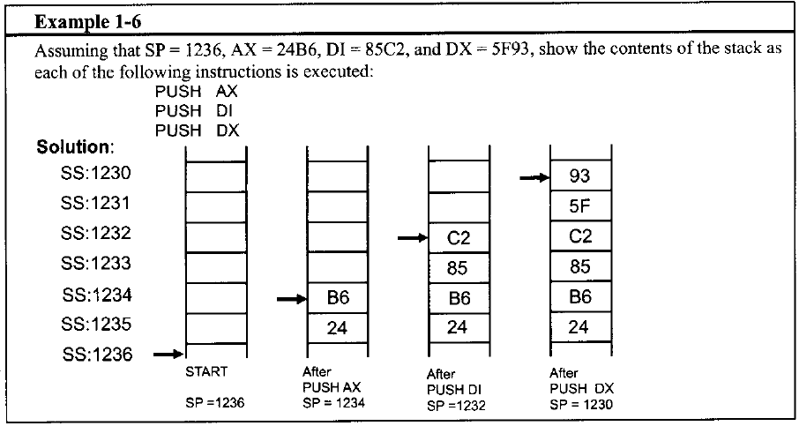
Push & Pop
16-bit operation
Little endian or big endian?

Slide 41
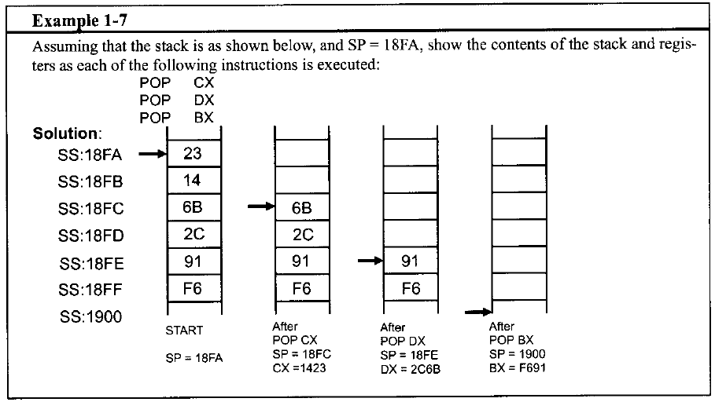
Push & Pop

Slide 42
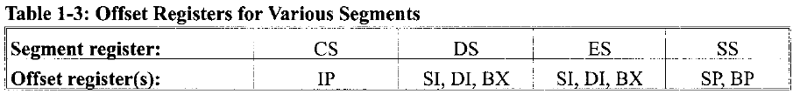
Extra Segment
An extra data segment, essential for string operations
Logical address of a piece of data: ES:offset
Offset value: e.g., 0000H, 23FFH
Offset registers for data segment: BX, SI and DI
In Summary,

Slide 43
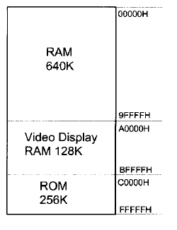
Memory map of the IBM PC
1MB logical address space
640K max RAM
In 1980s, 64kB-256KB
MS-DOS, application software
DOS does memory management; you do not set CS, DS and SS
Video display RAM
ROM
64KB BIOS
Various adapter cards
Notes:
It seems that all address space is assigned to only memory. So what about I/O devices?

Slide 44
BIOS Function
Basic input-output system (BIOS)
Tests all devices connected to the PC when powered on and reports errors if any
Load DOS from disk into RAM
Hand over control of the PC to DOS
Recall that after CPU being reset, what is the first instruction that CPU will execute?

Slide 45
Key Content
Internal organization of 8086
Registers, pipelining
Chip interface of 8086
Memory management in 8086
Addressing mode in 8086

Slide 46
80X86 Addressing Modes
How CPU can access operands (data)
80X86 has seven distinct addressing modes
Register
Immediate
Direct
Register indirect
Based relative
Indexed relative
Based indexed relative
Take the MOV instruction for example
MOV destination, source
Destination and source should have the same size

Slide 47
Register Addressing Mode
Data are held within registers
No need to access memory
E.g.,
Data can be moved among ALL registers except CS (can not be set) and IP (cannot be accessed by MOV)

Slide 48

Immediate Addressing Mode
The source operand is a constant
Embedded in instructions
No need to access memory
E.g.,
Immediate numbers CANNOT be moved to segment registers
How to change the value of a segment register?

Slide 49
Direct Addressing Mode
Data is stored in memory and the address is given in instructions
Segment address in the data segment (DS) by default
Need to access memory to gain the data
E.g.,

Slide 50
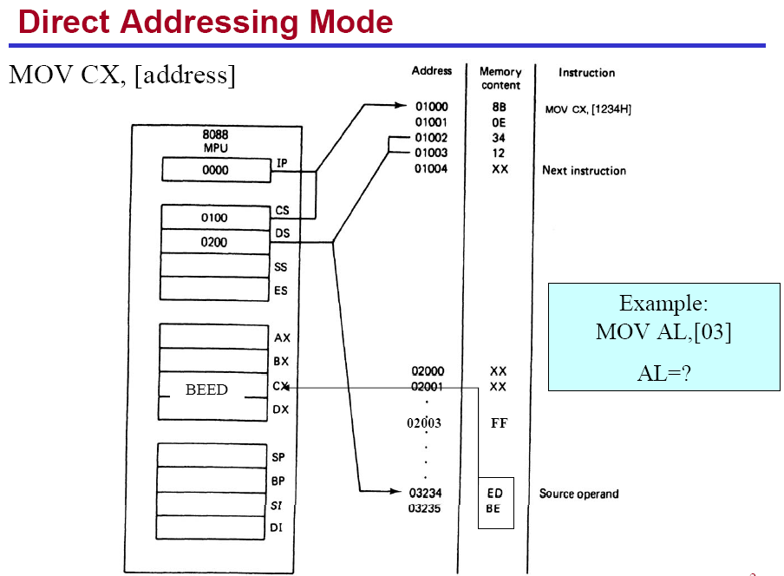

Slide 51
Register Indirect Addressing Mode
Data is stored in memory and the address is held by a register
Segment address in the data segment (DS) by default
Registers for this purpose are SI, DI, and BX
Need to access memory to gain the data
E.g.,

Slide 52
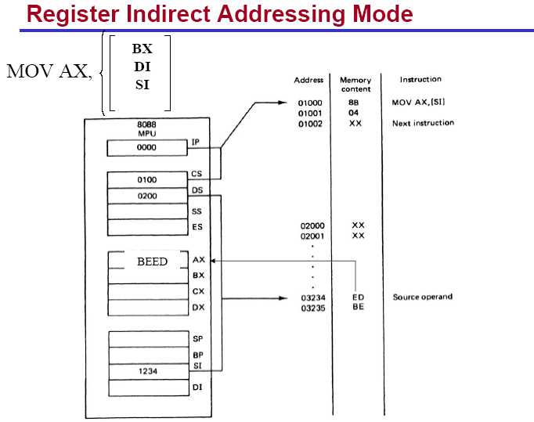

Slide 53
Based Relative Addressing Mode
Data is stored in memory and the address can be calculated with base registers BX and BP as well as a displacement value
The default segment is data segment (DS) for BX, stack segment (SS) for BP
Need to access memory to gain the data
E.g.,

Slide 54
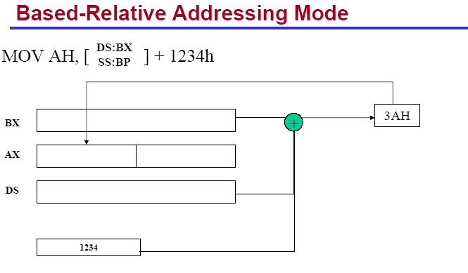

Slide 55

Indexed Relative Addressing Mode
Data is stored in memory and the address can be calculated with index registers DI and SI as well as a displacement value
The default segment is data segment (DS)
Need to access memory to gain the data
E.g.,

Slide 56
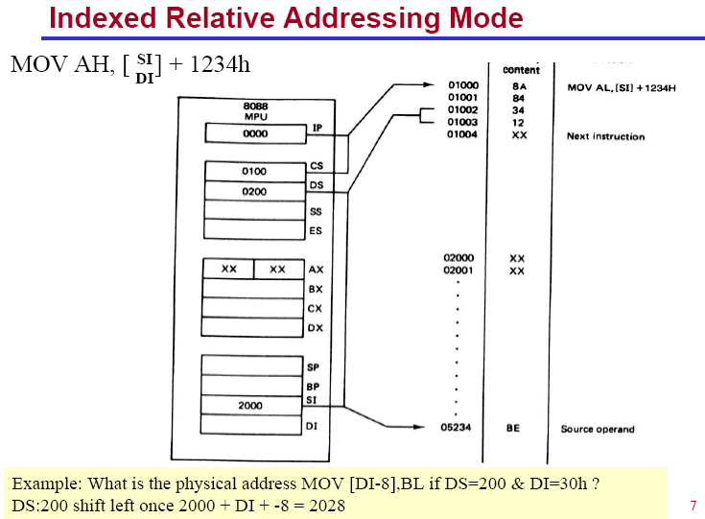

Slide 57

Based Indexed Relative Addressing Mode
Combines based and indexed addressing modes, one base register and one index register are used
The default segment is data segment (DS) for BX, stack segment (SS) for BP
Need to access memory to gain the data
E.g.,

Slide 58
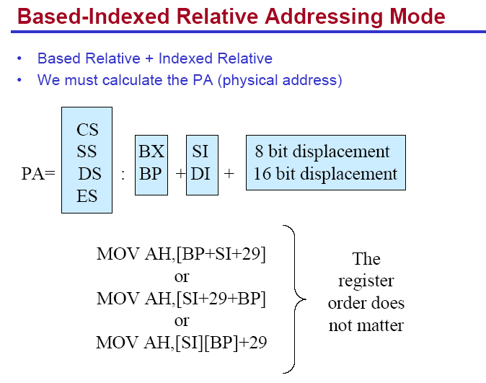

Slide 59
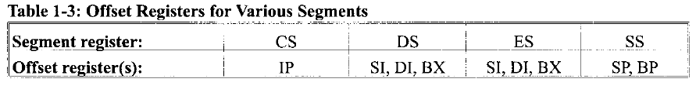
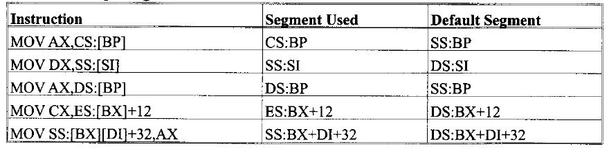
Segment Overrides
Offset registers are used with default segment registers
80X86 allows the program to override the default segment registers
Specify the segment register in the code

Slide 60
作业三
8086讲义，第五章习题
自己练习（不用上传）：1-3
上传：4，7-10，18-19，23
截止日期：3月19号

